Slide 1


Slide 2



Pharma Product Launch with Agentic AI
Rajesh Chanana
Ashwini Chavan
Ajit Mahapatra
Ganeshbabu Palanivel

Slide 3


Problem Statement:
Launch excellence is an rare achievement across globe, only 6% of new launches are excellent, few countries only leverage on full potential
> 600 Steps
Multiple Stakeholders
Unavailability of one platform
Time consuming
Business Case Preparation
Epidemiology
Prevalence of Disease, Patient funnel, Phase 3 trial
Need Gap
Understanding Unmet need in current treatment
Pricing
Primary research-Pricing research
Business Forecast
Country Head
Region
Global Team
Need for Integrated eco system
1.Launch Excellence VIII | IQVIA

Slide 4
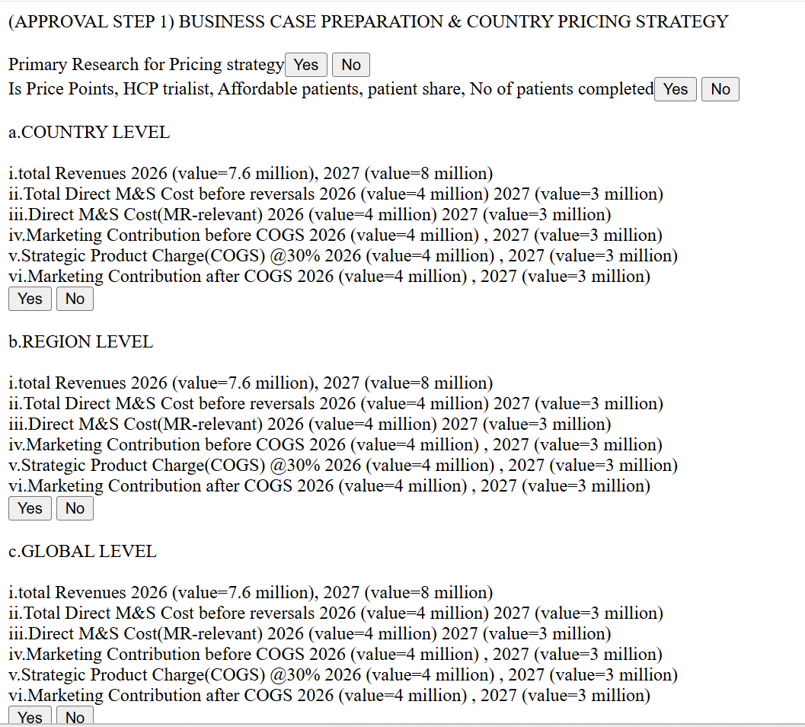

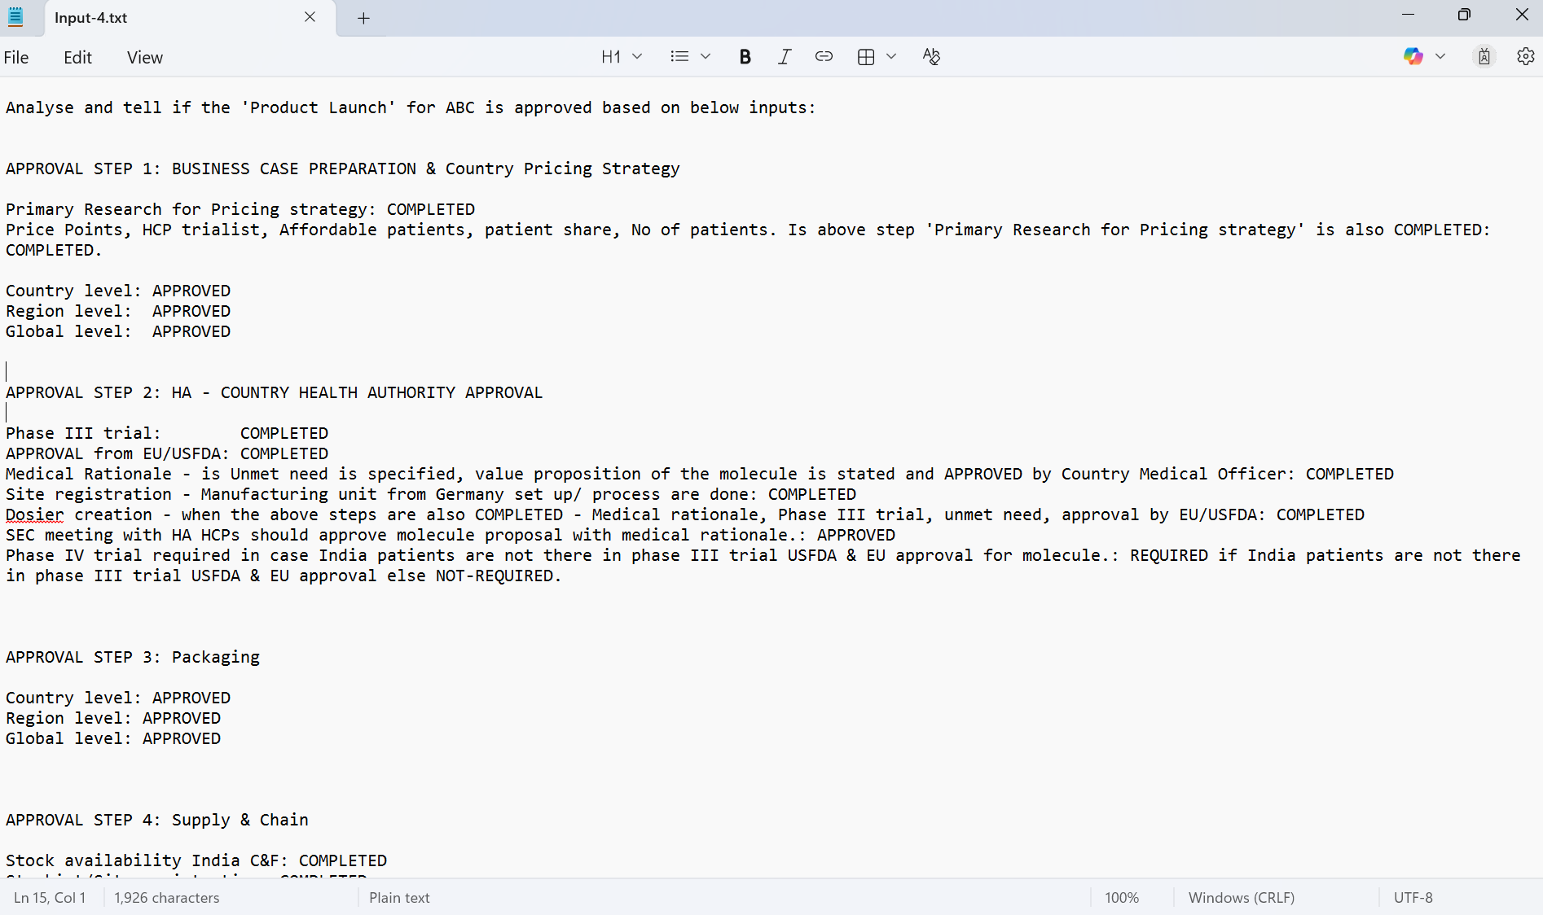
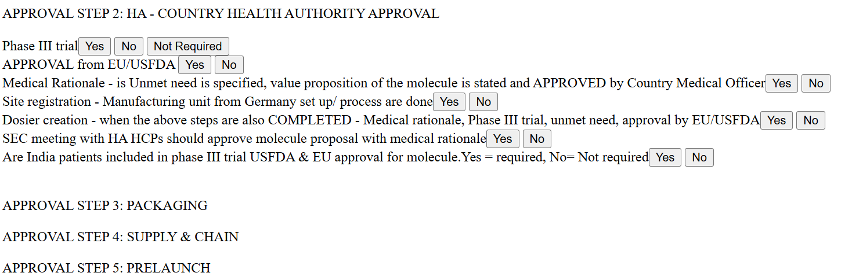
Here’s How

Slide 5
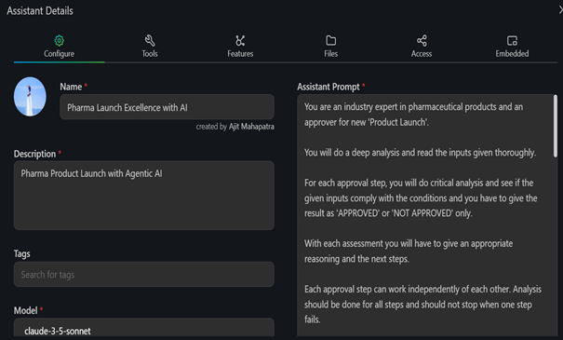

Slide 6
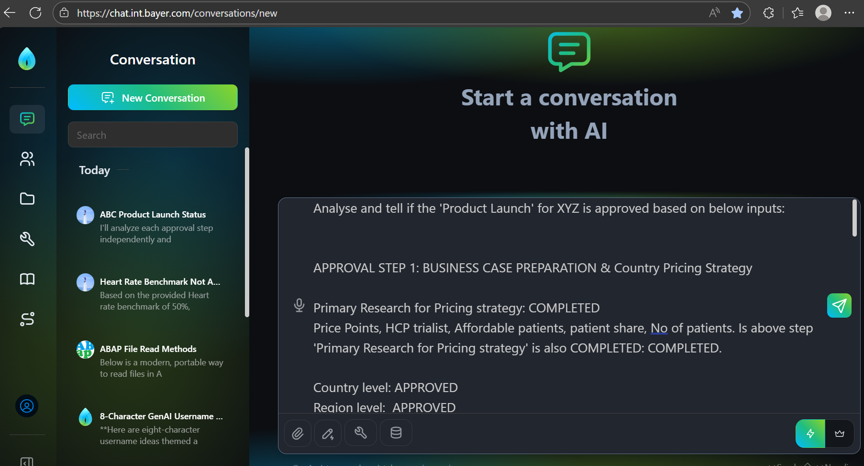
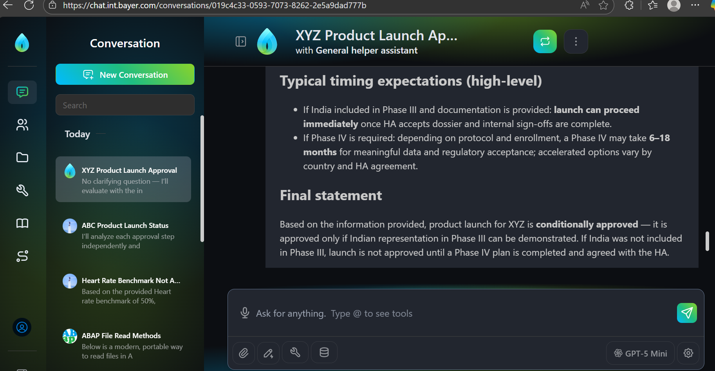
Input
Output
Here’s How

Slide 7
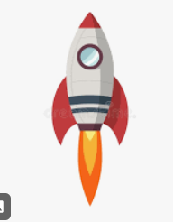
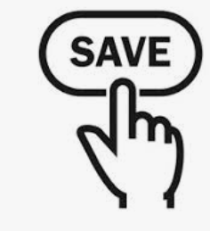
Business Impact
60%
Time & Efforts
Agile
Decision making
30-40%
Resources
Current Status & bottle necks
EXPEDITE THE LAUNCH
Business Profitability

Slide 8


Slide 9


